Slide 2
Introduction to Git and GitHub
NG QIAN HUI
Year 2 Bachelor Degree of Computer Science (Software Engineering), UTM
BETA MLSA
Notes:
Link to published module on Learn: https://docs.microsoft.com/en-us/learn/modules/learn-pr/github/introduction-to-github/

Slide 3
Prerequisites
GitHub account
Git Bash
Visual Studio Code
We will go through it later

Slide 4
Learning objectives
Understand basic GitHub flow using Git command and GitHub.dev
Open a repo
Create a branch
Commit changes to the branch
Push code changes
Create a pull request
Delete the branch
Merge code

Slide 5
Agenda
9.00 am – 10.00 am
What is GitHub?
Git terminologies
Basic GitHub flow
Work in Git Bash using Git Commands
Work in GitHub.dev
Summary

Slide 6
What is GitHub?

Slide 7
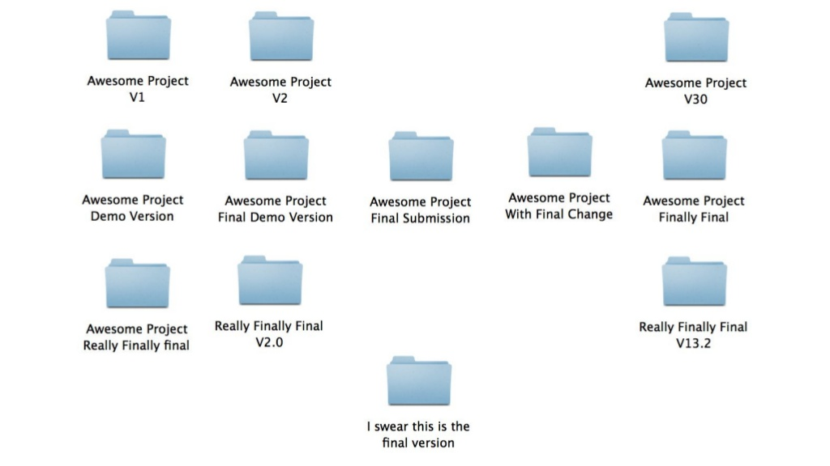
Problems
- Many version - Team collaboration - Device stolen/broken

Slide 8

GitHub (In General)
Space like Google Cloud to store files and folders using Git

Slide 9


Git
GitHub
version control system that lets you manage and keep track of your source code history
cloud-based hosting service that lets you manage Git repositories

Slide 10
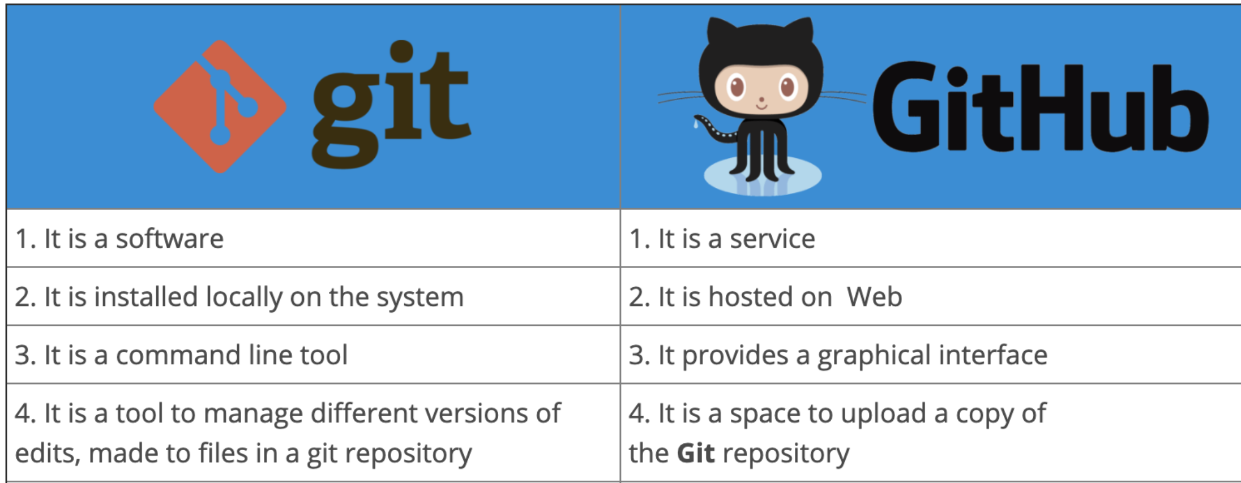
Difference between Git and GitHub

Slide 11
Install Git locally and create a GitHub account

Slide 12
Install Git
For window users (https://git-scm.com/download/win)
1. Click the "64-bit Git for Window Setup" link
2. Run the .exe file 3. Finish the installation using default settings for all 4. Reference video: https://www.youtube.com/watch?v=4xqVv2lTo40 For mac users ( https://git-scm.com/download/mac)
1. Get the binary installer and download it 2. Open the folder and then click the .pkg file (the software might be blocked by the Apple Security setting) 3. Installation is finished 4. Reference video: https://www.youtube.com/watch?v=F02LEVYEmQw

Slide 13
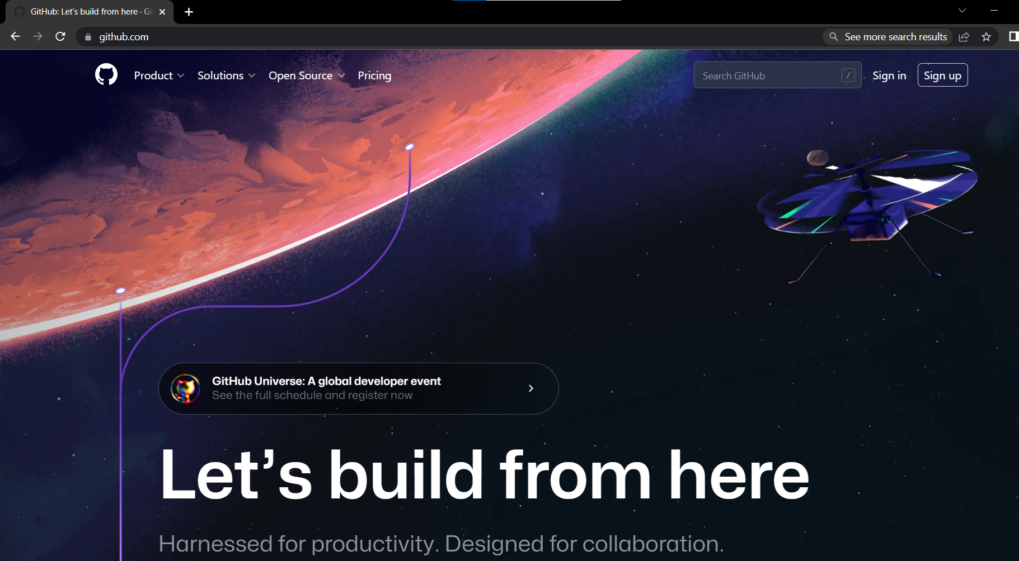
Sign up GitHub account
GitHub: https://github.com/

Slide 14
Git terminologies

Slide 15
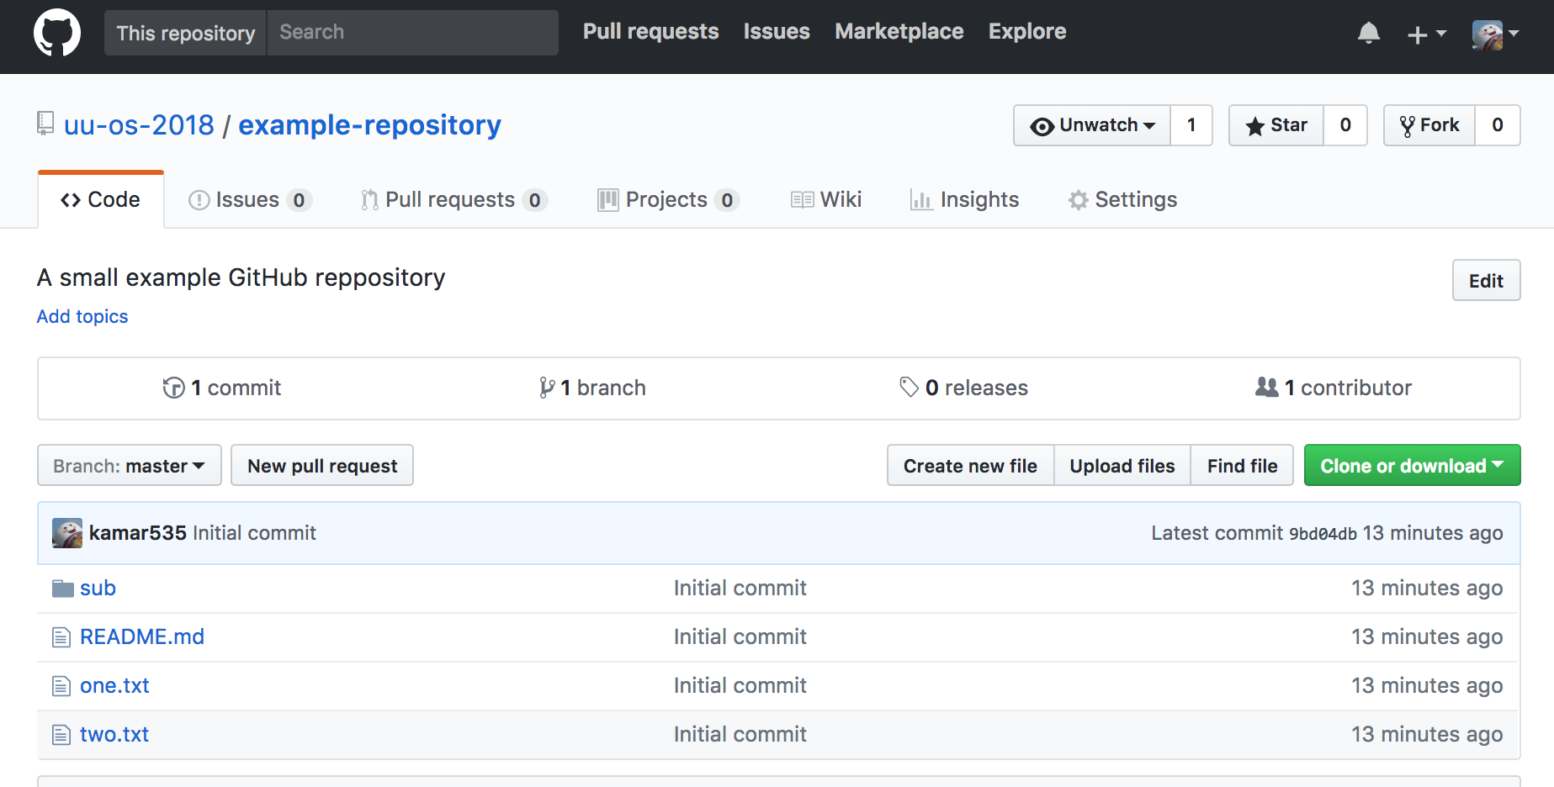
Repository (Repo)
Repository in Git is considered as a project folder.
Repository contains all of your project's files and each file's revision history.
repo name
project’s files
files history
Notes:
Branches are the preferred way to create changes in the GitHub flow. They provide isolation so that multiple people may simultaneously work on the same code in a controlled way. This model enables stability among critical branches, such as main, while allowing complete freedom for developers to commit any changes they need to meet their goals. Once the code from a branch is ready to become part of the main branch, it may be merged via pull request.
To learn more about GitHub branches, see About branches.

Slide 16


Remote and Local
Local Repo
Remote Repo
Repo is stored inside device like pc/laptop
Repo is stored on GitHub
Notes:
Branches are the preferred way to create changes in the GitHub flow. They provide isolation so that multiple people may simultaneously work on the same code in a controlled way. This model enables stability among critical branches, such as main, while allowing complete freedom for developers to commit any changes they need to meet their goals. Once the code from a branch is ready to become part of the main branch, it may be merged via pull request.
To learn more about GitHub branches, see About branches.

Slide 17
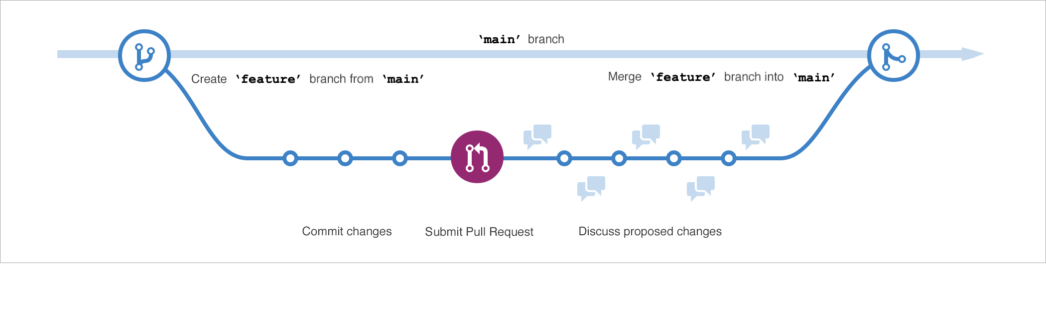
Branches
Branches are a version of the repository that diverges from the main branch. (collaboration, version controlling)
GitHub workflow
Notes:
Branches are the preferred way to create changes in the GitHub flow. They provide isolation so that multiple people may simultaneously work on the same code in a controlled way. This model enables stability among critical branches, such as main, while allowing complete freedom for developers to commit any changes they need to meet their goals. Once the code from a branch is ready to become part of the main branch, it may be merged via pull request.
To learn more about GitHub branches, see About branches.

Slide 18
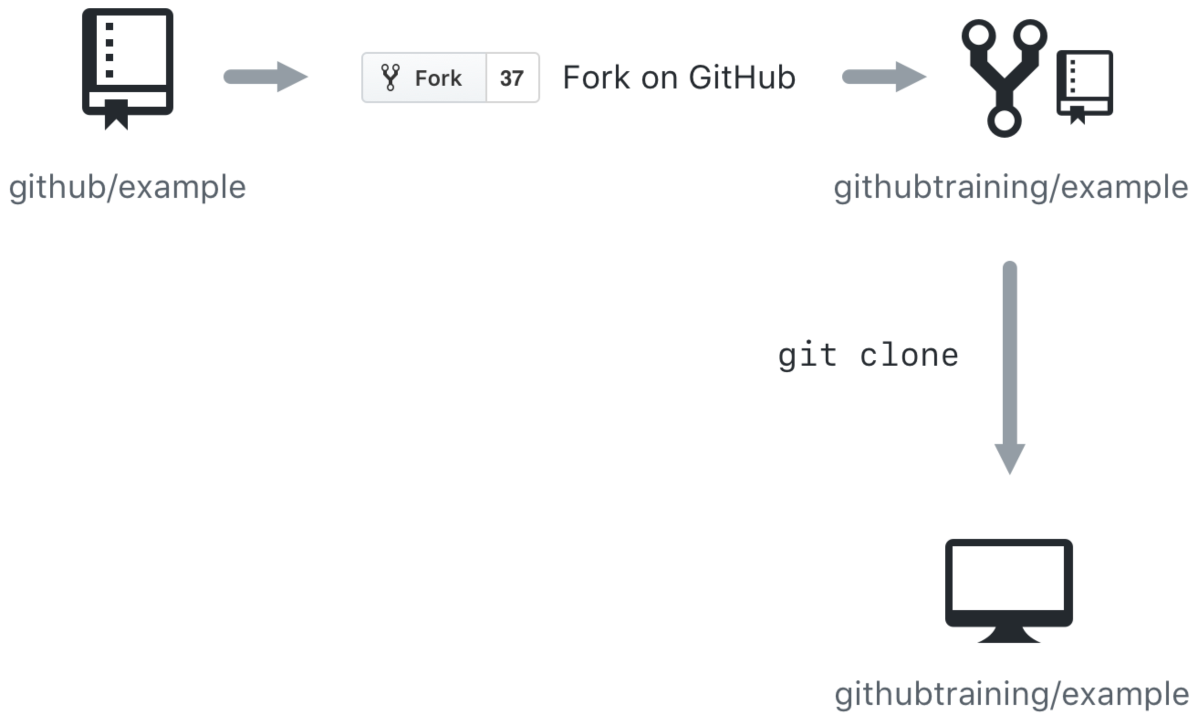
Cloning
GitHub provides multiple ways to copy a repository so that you can work on it.
Cloning a Repository
Cloning a repository will make a copy of the repository and its history on your local machine.
If you have write access to the repository you can push changes from your local machine to the remote repository that you originally cloned from (called the origin) as they're completed
Notes:
GitHub provides multiple ways to copy a repository so that you can work on it.
Cloning a Repository - Cloning a repository will make a copy of the repository and its history on your local machine. If you have write access to the repository you can push changes from your local machine to the remote repository (called the origin) as they're completed. To clone a repository you can use the git clone [url] command or the GitHub CLI's gh repo clone [url] command.
Forking a Repository - Forking a repository makes a copy of the repository in your GitHub account. The parent repository is referred to as the upstream while your forked copy is referred to as the origin. Once you've forked a repository into your GitHub account you can clone it to your local machine. Forking allows you to freely make changes to a project without affecting the original upstream repository. To contribute changes back to the upstream repository you create a pull request from your forked repository. You can also run git commands to ensure that your local copy stays synced with the upstream repository.
When would you clone a repository versus fork a repository? If you're working with a repository and have write access you can clone it to your local machine. From there you can make modifications and push your changes directly to the origin repository.
If you need to work with a repository created by another owner such as github/example and don't have write access, you can fork the repository into your GitHub account, and then clone the fork to your local machine. To see this visually, let's assume that your GitHub account is called githubtraining for this example. Using the GitHub website you can fork githubtraining or any other examples into your account. From there you can clone the forked version of the repository to your local machine. These steps are shown in the following image.
Changes can be made to your local copy of githubtraining/example and then pushed back to your remote origin repository (githubtraining/example). The changes can then be submitted to the github/example upstream repository using a pull request as shown next.
To learn more, see Fork a repo.

Slide 19
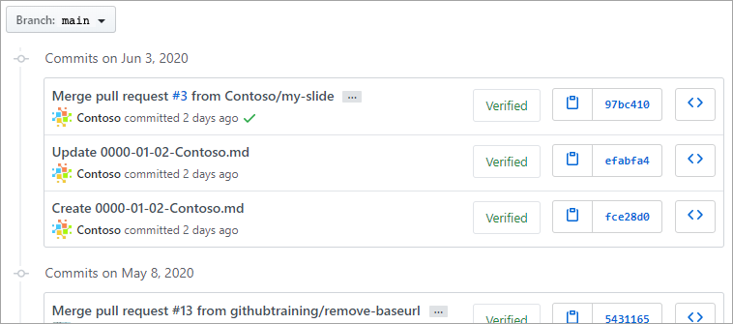
Commits
Commit will save changes made on repo locally
Notes:
A commit is a change to one or more files on a branch. Every time a commit is created, it is assigned a unique ID and tracked, along with the time and contributor. This provides a clear audit trail for anyone reviewing the history of a file or linked item, such as an issue or pull request.
To learn more about GitHub commits, see Committing and reviewing changes to your project.

Slide 20
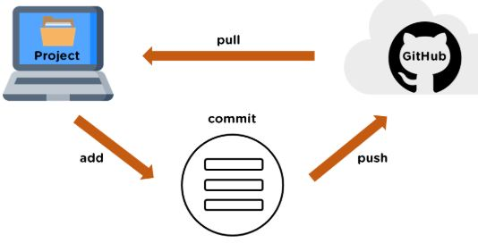
Push
Push is an act of uploading commits(changes) from your local repository to a remote repository
Notes:
A pull request is the mechanism used to signal that the commits from one branch are ready to be merged into another branch. The developer submitting the pull request will often request one or more reviewers to verify the code and approve the merge. These reviewers have the opportunity to comment on changes, add their own, or use the pull request itself for further discussion. Once the changes have been approved (if approval is required), the pull request's source branch (the compare branch) may be merged in to the base branch.
To learn more about GitHub pull requests, see About pull requests.

Slide 21
Pull
Fetch and download content from a remote repository and immediately update the local repository to match that content.
Push – post
Pull - get
Notes:
A pull request is the mechanism used to signal that the commits from one branch are ready to be merged into another branch. The developer submitting the pull request will often request one or more reviewers to verify the code and approve the merge. These reviewers have the opportunity to comment on changes, add their own, or use the pull request itself for further discussion. Once the changes have been approved (if approval is required), the pull request's source branch (the compare branch) may be merged in to the base branch.
To learn more about GitHub pull requests, see About pull requests.

Slide 22
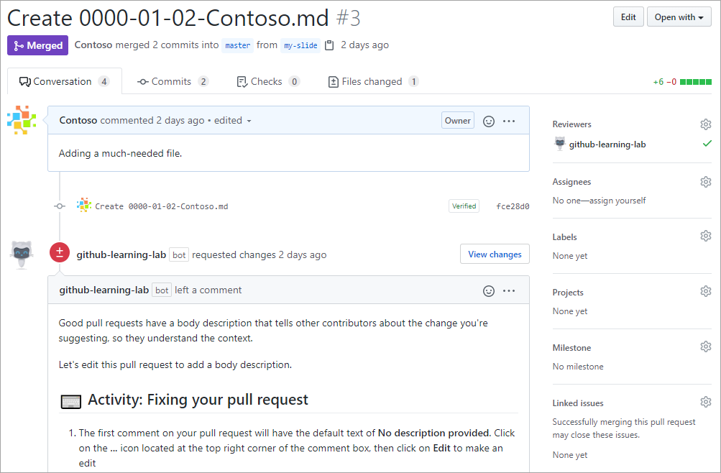
Pull Requests
A pull request is used to notify others about changes you have pushed
Notes:
A pull request is the mechanism used to signal that the commits from one branch are ready to be merged into another branch. The developer submitting the pull request will often request one or more reviewers to verify the code and approve the merge. These reviewers have the opportunity to comment on changes, add their own, or use the pull request itself for further discussion. Once the changes have been approved (if approval is required), the pull request's source branch (the compare branch) may be merged in to the base branch.
To learn more about GitHub pull requests, see About pull requests.

Slide 23
Workshop walk-through using Git Commands

Slide 24
Workshop walk-through using Git
Create a repo, create a branch, make a change, push and pull it

Slide 25
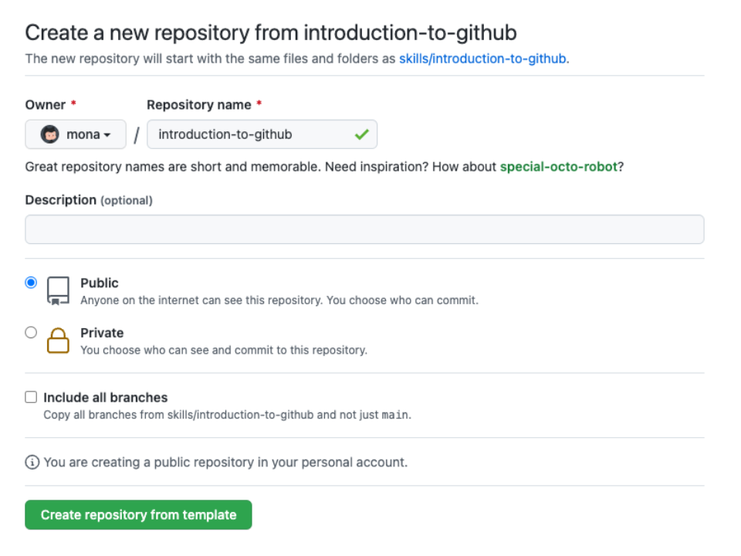
1. Create a repo in GitHub

Slide 26
2. Download online repo to local device
git clone <repo url>
3. Change directory (folder)
cd <directory name>
4. Open file/folder using default IDE
code .

Slide 27
5. Add new or changed file to the staging area (preview)
git add <file-name> (one)
git add . (add every files to the tracking)
6. Save changes to local repo
git commit –m “commit message”
7. Upload local repo content to remote repo
git push

Slide 28
8. Get the latest changes from the remote
git pull

Slide 29
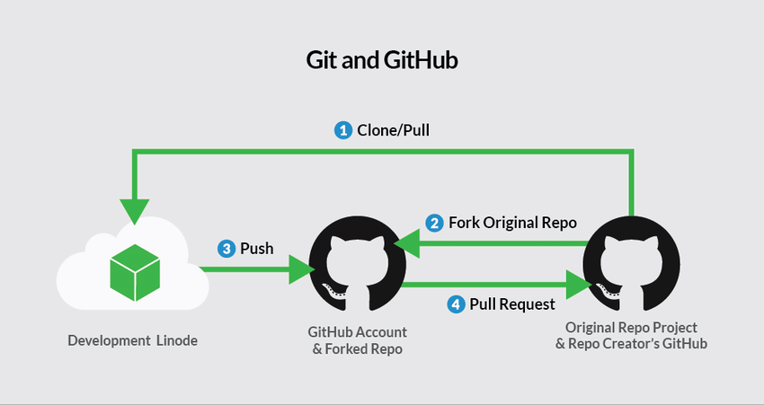

Slide 30
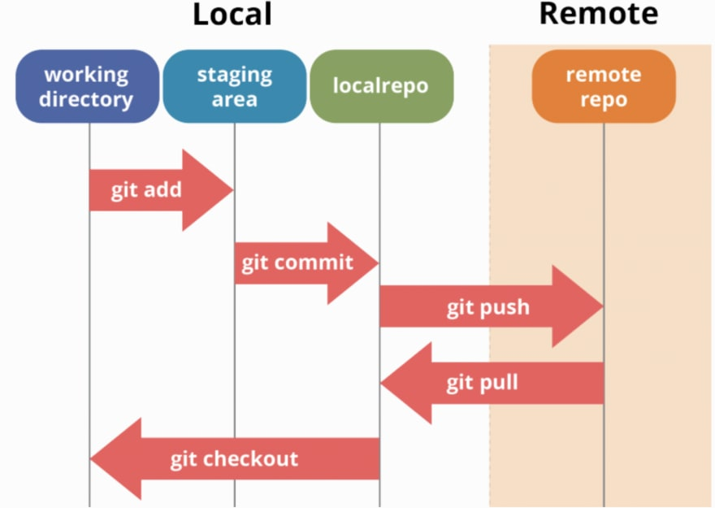

Slide 31
Revert back to a certain version of code
Get and display all of the commits in a repo’s history
git log
2. Revert back
git reset –-hard <commit number> (revert back to <commit number> version)
git reset –hard origin/master (revert back to the remote/GitHub version)
3. Override remote branch code with local
git push –f origin main

Slide 32
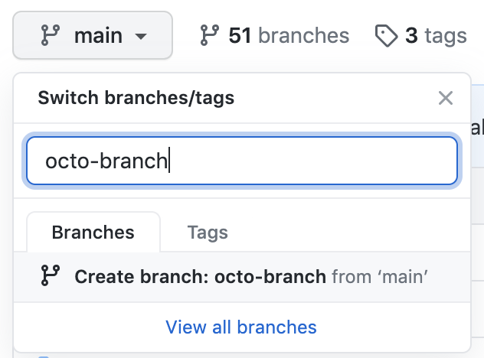
Working with branches
Create new branch

Slide 33
Working with branches
2. Create and switch branch locally
git checkout –b <branch-name>
3. Check available branches
git branch
4. Add new changes to the staging area
git add .
5. Save changes git commit –m “commit message”

Slide 34
Working with branches
5. Push the changes of the local branch to remote (GitHub) git push origin <branch name>

Slide 35
Workshop walk-through using GitHub.dev

Slide 36
Microsoft Learn Student Ambassador (MLSA)

Slide 37

https://studentambassadors.microsoft.com/

Slide 38
What is Microsoft Learn Student Ambassadors Program ?
Program to bring together all the students from all over the world who have the passion for Technology, have the desire and craze to learn more about technology and help the community.
The Ambassadors get an opportunity to interact with their peers, mentors, Professionals, learn various Microsoft technologies, and implement it in real world. All about MLSA: https://dev.to/tina_popli/all-about-microsoft-learn-student-ambassadors-mlsa-22nc

Slide 39

Please tell us how you liked this workshop by filling out this survey:
https://forms.office.com/r/GSubwum3Rr

Slide 40
Thank you ! Till we meet again

Slide 41
Question 1
What is the best way to report a bug to a GitHub project?
Send an email to a project owner.
I don't bother reporting software bugs because there's no transparency and they never get fixed anyway.
Search for the bug in the project's existing issues and create a new one if it hasn't been reported yet.
Notes:
Explanation: A project's issues are visible to anyone who has access to the project, so you may find a resolution is already planned or available. Otherwise, you can create and track the issue yourself.

Slide 42
Question 1
What is the best way to report a bug to a GitHub project?
Send an email to a project owner.
I don't bother reporting software bugs because there's no transparency and they never get fixed anyway.
Search for the bug in the project's existing issues and create a new one if it hasn't been reported yet.
Notes:
Explanation: A project's issues are visible to anyone who has access to the project, so you may find a resolution is already planned or available. Otherwise, you can create and track the issue yourself.

Slide 43
Question 2
Suppose you have created a bug fix on a new branch and want it to become part of the next production build generated from the `main` branch. What should you do next?
Copy your branch changes and commit them directly to the `main` branch.
Create a pull request to merge your new branch into the `main` branch.
On second thought, maybe I won't share this fix. I'll just put it in my own private version of the source code.
Notes:
Explanation: Pull requests are the correct way to communicate that commits are ready for review and ultimate inclusion on the `main` branch.

Slide 44
Question 2
Suppose you have created a bug fix on a new branch and want it to become part of the next production build generated from the `main` branch. What should you do next?
Copy your branch changes and commit them directly to the `main` branch.
Create a pull request to merge your new branch into the `main` branch.
On second thought, maybe I won't share this fix. I'll just put it in my own private version of the source code.
Notes:
Explanation: Pull requests are the correct way to communicate that commits are ready for review and ultimate inclusion on the `main` branch.

Slide 45
Question 3
Suppose you'd like to work with a project on GitHub but you don't have write access to the project. What can you do to contribute?
Fork the project's repository to your GitHub account, clone the forked repository to your local machine, push changes to your repository, and submit a pull request to the target (upstream) repository.
Clone the project to your local machine and push updates directly to the project repository.
Use git commands to make a copy of the project so that you can work locally. Submit an issue to get your changes into the target repository.
Notes:
Explanation: GitHub provides forking functionality designed to allow you to work with projects where you aren't an owner or don't have write access. Forking makes a remote copy of the project in your repository that you can then clone locally. To submit updates to the target repository (upstream repository) you can submit a pull request.

Slide 46
Question 3
Suppose you'd like to work with a project on GitHub but you don't have write access to the project. What can you do to contribute?
Fork the project's repository to your GitHub account, clone the forked repository to your local machine, push changes to your repository, and submit a pull request to the target (upstream) repository.
Clone the project to your local machine and push updates directly to the project repository.
Use git commands to make a copy of the project so that you can work locally. Submit an issue to get your changes into the target repository.
Notes:
Explanation: GitHub provides forking functionality designed to allow you to work with projects where you aren't an owner or don't have write access. Forking makes a remote copy of the project in your repository that you can then clone locally. To submit updates to the target repository (upstream repository) you can submit a pull request.

